Slide 1



IT550 Information Processing using Legislative text
AKANKSHA PORWAL 202118017
DIPSHI JAIN 202118018

Slide 2

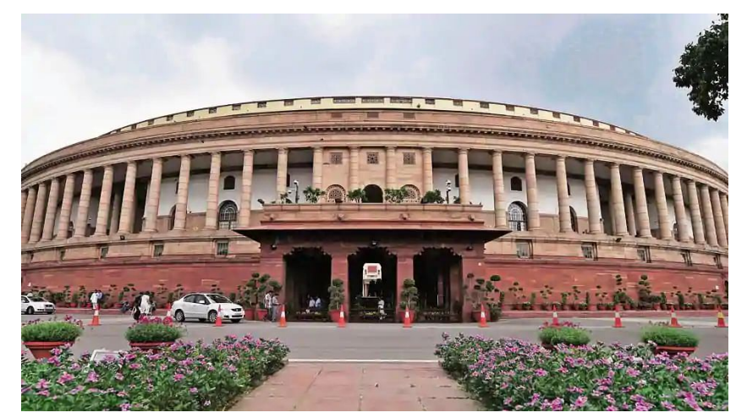



INTRODUCTION
PROBLEM STATEMENT
LOK SABHA SITTINGS
METHADOLOGY
INDEX
NER(Named-Entity-Recognition)
POS(Part-of-Speech tagging)
Calculate Stats
Nominatim API

Slide 3
Introduction
The Lok Sabha known as the House of the Peoples, is the lower house of India’s Parliament, with the upper house being the Rajya Sabha. Members of the Lok Sabha are directly elected by the people of India, on the basis of universal suffrage to represent their respective constituencies, and they hold their seats for five years or until the body is dissolved by the President on the advice of the council of ministers
The maximum strength of the House envisaged by the Constitution is 552. It acts as a forum to debate and discuss matters of national concern, and, thus, plays an essential role in Indian Politics. In this project, we attempt to perform a preliminary analysis of the Lok Sabha Speeches. We have also considered the 17th Lok Sabha dataset (the latest included).

Slide 4
PROBLEM STATEMENT
The primary goal of this research is to do an in-depth analysis of the Lok Sabha debates. To achieve this goal, we divided the entire research into three problems:-
The first issue is to scrap the data from the PDFs so that we can easily use that data for the analysis.
2. This section involves labeling the text scraped from PDFs and analyzing it.
3. The third issue is to scrap the locations mentioned in the debates of Lok Sabha, validating them and then visualizing them.

Slide 5
METHODOLOGY
NER(Named Entity Recognition)
POS(Part-of-Speech Tagging)
Ready for Analysis
Data Preprocessing
We have used the printed versions of the debate for our analysis. In the project, we have scrapped the data from those printed debates, preprocessed it, scraped the locations mentioned in each Lok Sabha session and analysed the locations

Slide 6
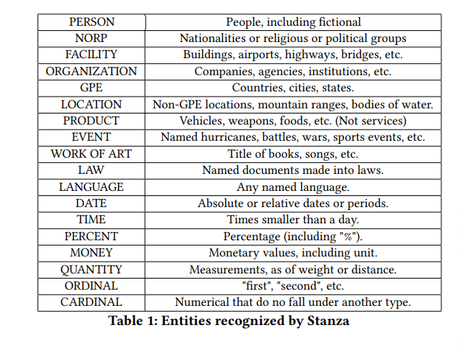
Ner
TABLE -1
• NER was performed using Stanza45, developed by Stanford NLP Group.
• As of now, Lok Sabha NER has been performed from 1 to 17th Lok Sabha Data.
• A description of each label is given in Figure.

Slide 7
Other NER parameters
EVENT
EVENT tag is given to historically significant occurrences or natural disasters. For some, we see the following events to have the maximum frequency.
• Independence
• The Five Year Plan
• The Green Revolution
• Olympics
Based on our understanding of the Indian political situation at the time, these topics, other than the Olympics, were a part of the political debate surrounding the new GST bill and the Aadhar Act.
2. NORP
According to Table 1, the NORP tag is used for nationalities or religious or political groups. The following were classified as NORP with maximum frequency according to NER.
• Indians
• Dalits
• Hindu
• Tamil
• Muslim
This set represents the major religions and social groups in India, and most of these have been a part of several political debates for a very long time.
3. PERSON
PERSON is used for people as seen in Table 1. The following were classified as PERSON with maximum frequency according to NER.

Slide 8
Parad Mishra, Kunwar Pushpendra Singh Chandel, and Saugata Roy were members of the parliament 16th Lok Sabha. On the other hand, Puratchi Thalaivi Amma, popularly known as Amma, passed away in 2016 and the same caused a lot of turmoil in the State of Tamil Nadu.
4. LANGUAGE
Any named language is classified as LANGUAGE by NER as observed in Table 1. The following were classified as LANGUAGE with maximum frequency according to NER.
• English
• Hindi
• Tamil
• Marathi
• Telugu

Slide 9
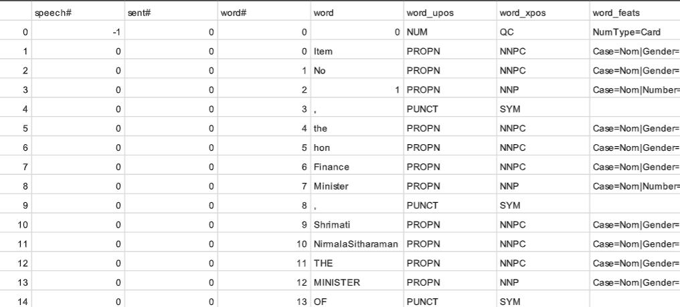
POS
• Lok Sabha’s 1 to 17 data files have been POS-tagged.
• POS tagging is a process of assigning one of the parts of speech to the given word.
POS was performed using Stanza45, developed by Stanford NLP Group.

Slide 10
Calculate stats
In calculating stats we have calculated the total number of files each amendment was having, as the data is very large we have considered 200 random files from each amendment.
Through NER files we have recognized Nouns and counted their frequency.
Through POS files we have recognized Pronouns and counted their frequency.

Slide 11
Nominatim APi
First, we have scrapped all the location data from The statistics to optimize the processing.
Then we have concatenated statistics for all files for each folder and give it to the nominatim API.
Nominatim API returns detailed datasets for any address with its longitude and latitude it also recognizes the mixed language and it merges multiple names of the same place in one entity. As its longitude and latitudes will be the same.
Then have scrapped frequencies of longitude and latitude.

Slide 12
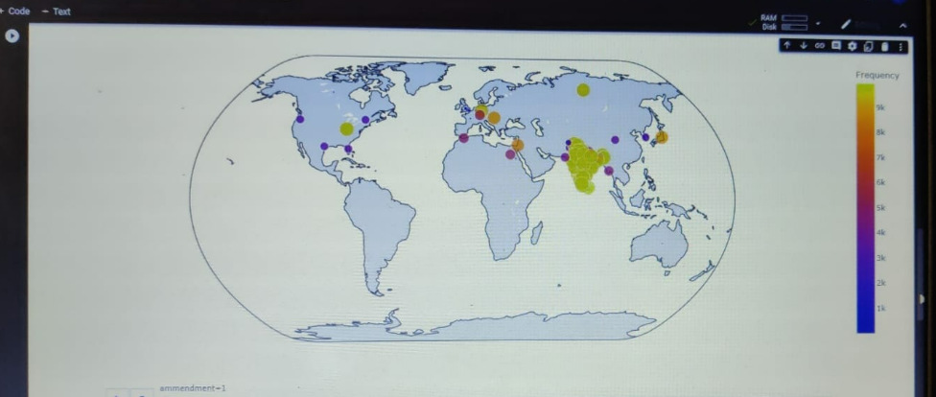
Visualization
We have used Plotly as it provides an interactive graph and provides high-resolution graphics, we have added a slider to distinguish each amendment from one another and plotted the data according to its longitude and latitudes.

Slide 13
FUTURE WORK
In the future, we will do an in-depth analysis of each amendment. For now, we are only doing 200 random files from each amendment.
We will analyze according to problems in areas which was mentioned in the amendments and which areas were related
We will create a dashboard.

Slide 14

Thank YOU!
MSc. Data Science Batch
Sem-II
2022

